Slide 1
PROVING YOUR FAITH What is your Absolute?

Slide 2
QUESTION …
Why change service times when this seems to be working just fine?

Slide 3
QUESTION RESPONSE …
Why is time what it is now?
Why change?
Minister Travel (7-8 hr drive)
For those that don’t eat Sun mornings, a big lunch then wasted evening
Reserve some energy for evening services, bible studies, etc

Slide 4
TESTIMONIES FROM BYC
We had 10 campers go to BYC
Bro Juan Cotto - leader for the 14-15 YO
Bro Jas Audet - leader for the 10-13 YO
Bro Juan Galvan - Ran sound equipment for the youth tabernacle
Bro Nathaniel
28 Young Men, leader for the 16 - 18 YO
Bro Jonathan Houching - Bro Nathan Bryant

Slide 5
CURRENT EVENTS
Trump Assassination Attempt
Attacks on Israel continue
… how will these things end?

Slide 6
I JOHN 1 : 1 - 6
. . . the Word from the beginning made manifest . . .

Slide 7
What is your absolute?

Slide 8
What is an absolute?

Slide 9
AN ABSOLUTE The foundation you are built upon. The thing you hold most important.

Slide 10
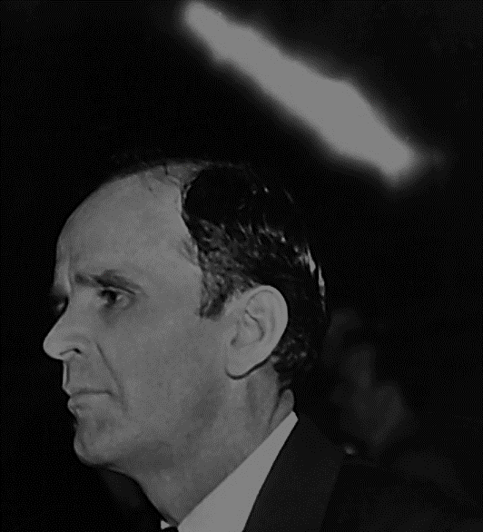
63-1201M An Absolute
62 It don’t make any difference what others want to believe. To the individual, you are tied to That. That’s your ultimate. That’s the…that’s the last word. And then if He is the Word, then This must be the last word. This must settle it. …

Slide 11
63-1201M An Absolute
… Whatever That says, That’s that scarlet thread. That is Christ. And anything contrary to That, I know nothing about it. That’s what we want to know, is what this Word says; for I am tied to Christ, and Christ is the Word. You get it now?

Slide 12
63-1201M An Absolute
63 And the portion of His Word that’s lotted for this day, His Holy Spirit is here to manifest that portion of Word.

Slide 13
What is your absolute? - CNN? Fox? - America? - Capitalism? - Socialism?

Slide 14
What is your absolute? - Is it the Bible? - Which version of the bible? - How do you know? - Do I have to repeat word-for-word the bible, and that is the Absolute?

Slide 15
What is your absolute? - Is it the words of William Branham? - Is it based on how strictly I repeat what William Branham said? - Is the absolute accurate reciting of the words of the prophets?

Slide 16
What is your absolute? - Is it the pastor? - is the Church

Slide 17
ELOHIM

Slide 18
ELOHIM Hebrew word for majesty. Plural, but understood as singular.

Slide 19
THE LOGOS

Slide 20
ADAM

Slide 21
The Lamb in Eden

Slide 22
Abraham’s Covenant

Slide 23
David & Abraham’s Covenant

Slide 24
JESUS CHRIST

Slide 25
You are what you eat.

Slide 26
What do you see?

Slide 27
What is your absolute? - CNN? Fox? - America? - Capitalism? - Socialism?

Slide 28
What is your absolute? - Is it the Bible? - Which version of the bible? - How do you know? - Do I have to repeat word-for-word the bible, and that is the Absolute?

Slide 29
What is your absolute? - Is it the words of William Branham? - Is it based on how strictly I repeat what William Branham said? - Is the absolute accurate reciting of the words of the prophets?

Slide 30
What is your absolute? - Is it the pastor? - is the Church

Slide 31
63-0728 Christ Is The Mystery Of God Revealed
611 And His Church stands alone. She is not hooked with nothing. But He was identified by God, being the body that God dwelt in; and the Church is identified by His Body, doing the same thing.

Slide 32
63-0728 Christ Is The Mystery Of God Revealed
She is His Body, the manifested Truth of His promised Word for the last days. And She, and She alone, stands by It. That’s why the devil is howling, these great organizations, to set up something to close Her up.

Slide 33
63-0728 Christ Is The Mystery Of God Revealed
They’ll never do it. She’ll be taken up, not closed up. She is now risen, and by the power of the vindicated Word promised to Her. Amen!

Slide 34
64-0705 The Masterpiece
166 Now at the harvest time, the Seed is back to its original Life, back to the Bible. Malachi 4 said it would be brought that way. Oh, oh, my! Must have all! To be this way, It must have all of the Word. Is that right?

